Slide 1
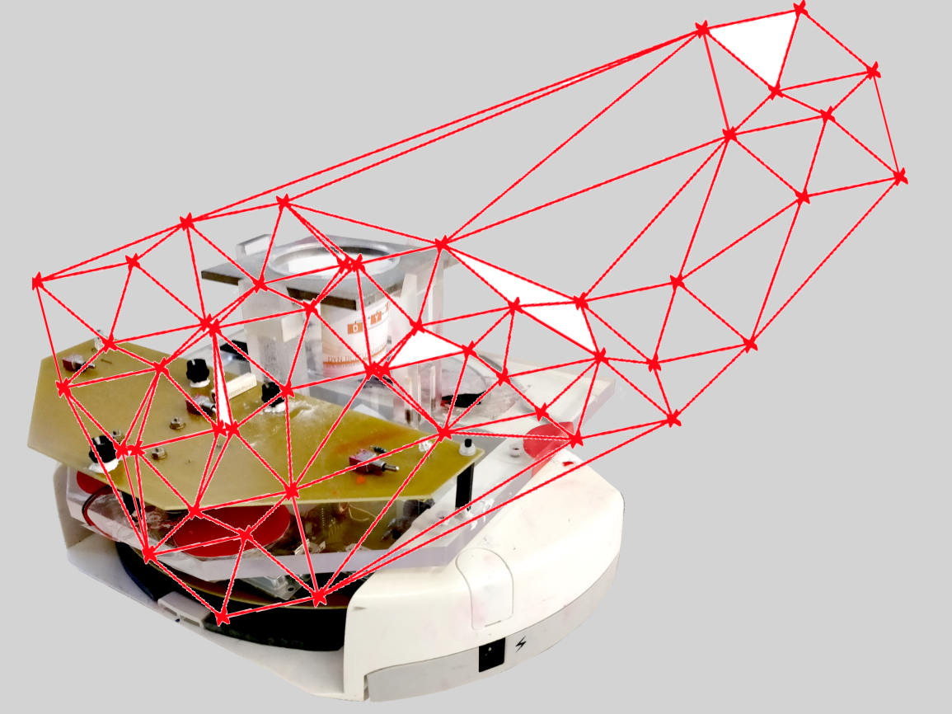
Project group SS18
Development of local positioning system for a pipe-less plant

Slide 2
Agenda
Introduction
Organization and workflow
Motivation and selection process
Radio-frequency identification
Simulation
Implementation
Demonstration
Conclusions and future work

Slide 3


Team & Organisation
Abdulrahman
WiFi Communication
Project Leader
Stephan
Plant Setup Simulation
Stefan
Software Implementation
Medhini
Existing setup

Slide 4
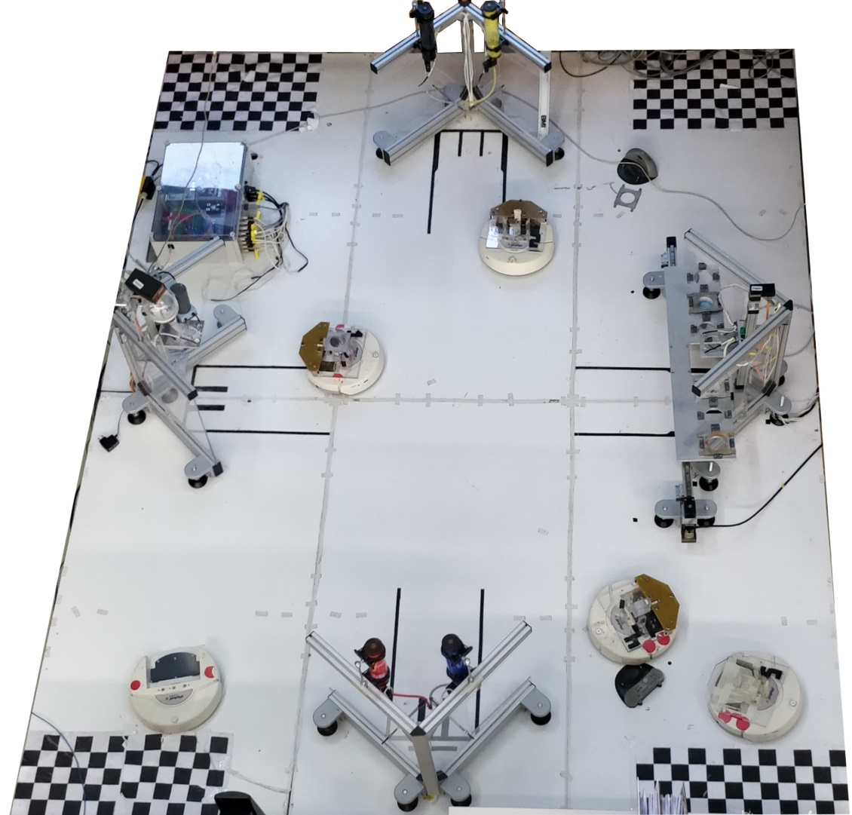
DYN Miniature Pipeless plant
General setup[3x4m]
4 AGVs
2 Color Stations
1 Mixing Station
1 Storage Station
Localization
1 Camera
LED pattern on AGV
Notes:
+ 1 slide camera ..+positoning system

Slide 5
Project objective
Research about alternative positioning system
Evaluate with simulation
Ultimate goal: improve positioning precision
Compare and develop practical proof of concept

Slide 6
Project motivation
Precise localization in any light conditions
Achieve low processing time
Ability to localize multiple robots
Develop a system without space limitation
Notes:
Working in all conditions

Slide 7
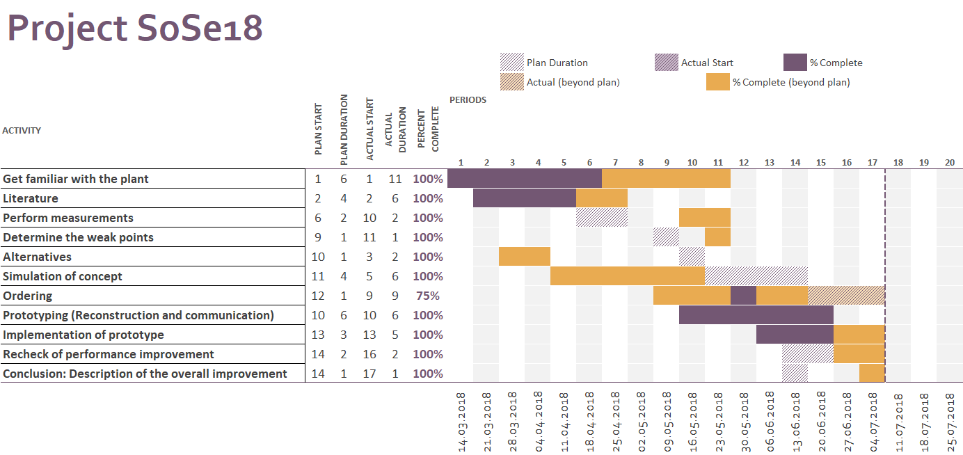
Project Workflow

Slide 8
Selection Process
Triangulation Method
Light dependant
Limited space
Pattern Recognition
Complex and cost intensive
Map-Based Localization
Drawbacks of multiple ultrasonic sensors
Radio-frequency identification
Light independent
Not space limited
Common concept of indoor localization

Slide 9

RFID (Radio Frequency Identification)
Object
Reader
RFID Tag
Radio Waves
Notes:
Technology works on sending radio frequency or radio waves. And it can be used to automatically identify or tracking an object. So RFID tag should be attached to the object, which wanted to be tracked.
the reader is continuously sending the radio waves. So when the tag is with in reader range, the tag start sending back feedback signal to the reader. And can track multiple objects in the same time

Slide 10
RFID System
RFID
Tags
Active
Passive
Reader
Semi-Passive
Notes:
- RFID main parts: …
- Active: has own power supply, passive: don’t has and relies on the radio waves which come from the reader for the source of energy, semi: has power supply but for transmitting the feedback signal it relies on the signal coming from reader.
Question?: So the rate of passive is less

Slide 11
RFID Reader
RFID Signal Generator
Microcontroller
Receiver / Signal Detector
Notes:
- Reader has main 3 parts: …..
- (click) Generator: which generates the radio waves.
(Click) And to receive signal coming back from tag, uses rec. or detector.
While microcontroller is used to process the information which are sent by the rfid or received from the tag.

Slide 12
RFID Tag
Memory
Controller
Rectifier Circuit
Transponder
Notes:
So main parts
Transponder: receives radio waves and sends the feedback, and get the energy from the waves comes from the reader,
the rectifier circuit stores the energy across the capacitor, and this energy used as supplier for the controller as well as the memory

Slide 13
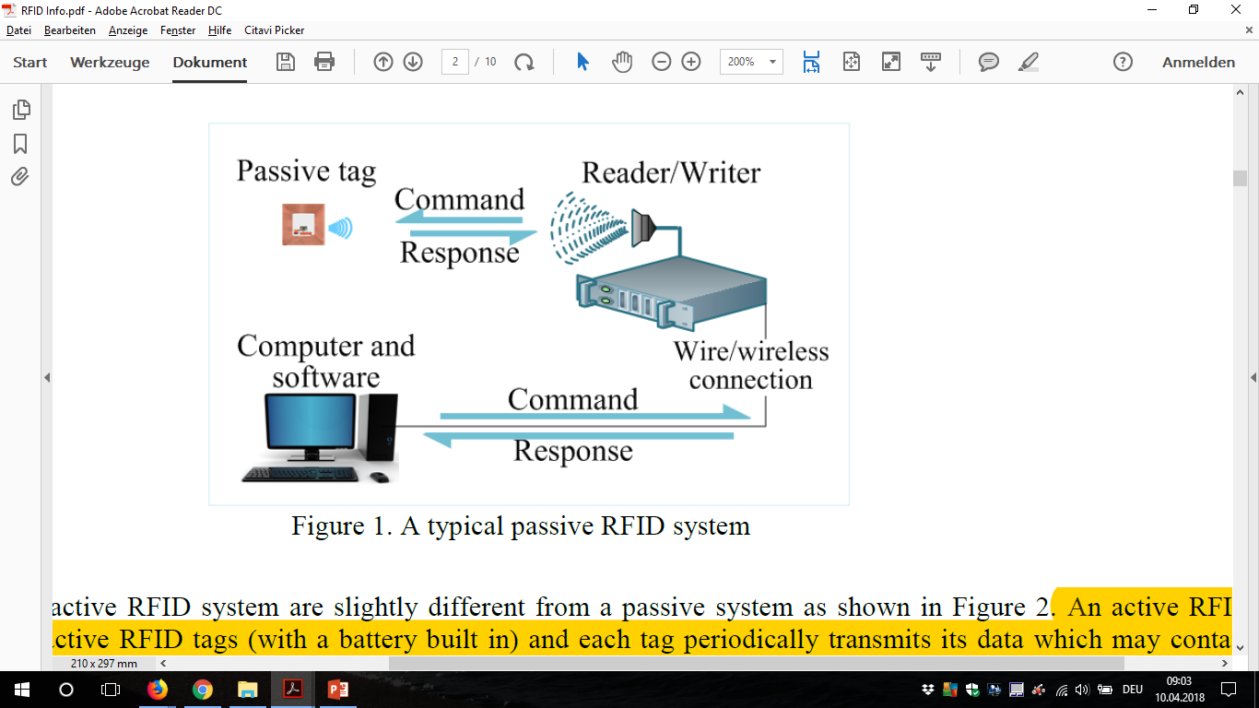
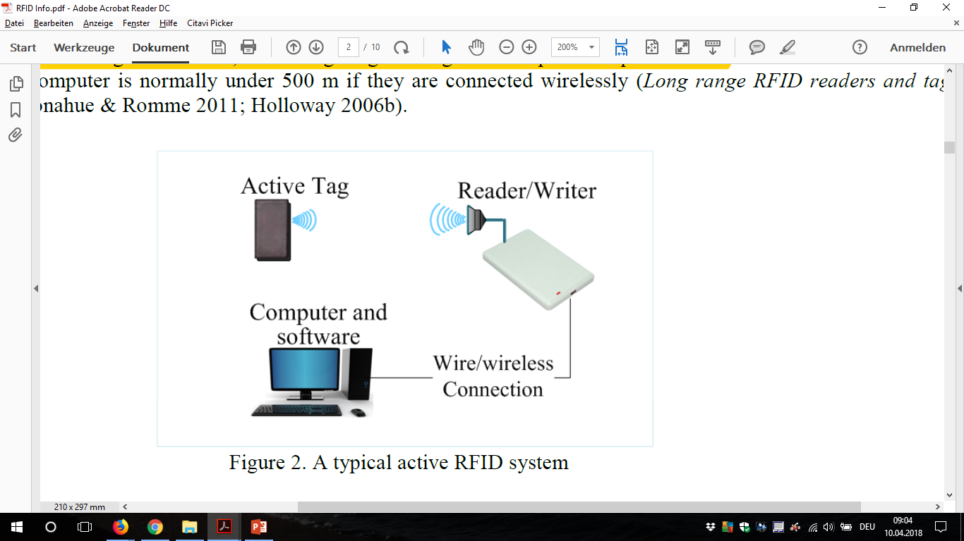
Plant Setup
Passive Active
Power for the passive tag is provided by the reader
Active systems reading range is longer

Slide 14
Implementation in our project
System 1 System 2
Multiple readers 1 reader at robot
1 active tag at robot many passive tags
Notes:
For less power consumption, and less components installation, less cost

Slide 15
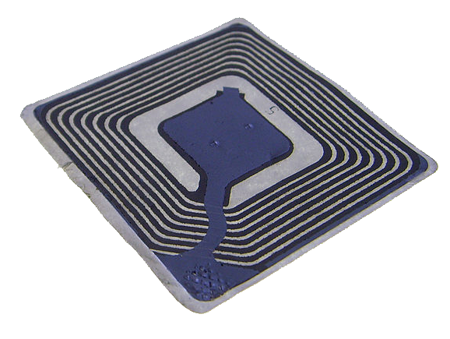
RFID Tags
Passive tag:
Paper type
Cheaper
Does not require power supply
Compact
Frequency of Operation:
125 kHz to 135 kHz
Range: 10 cm
Working Principle:
Inductive coupling (Near field coupling)

Slide 16
Working Principle
Inductive coupling (Near field coupling)
Induce enough Power into Tags
Synchronization clock to tag
Acts as a carrier for the return data from tags
RFID Reader
Notes:
So as we said before The RFID is continuously sending radio waves with particular frequency, so these radio waves have 3 purposes
(Click)
(Click)
(Click)

Slide 17
Inductive coupling (Near field coupling)
Rectifier
RFID Reader
Power
Load
Clock
Controller
Notes:
So in this case the reader and tag are so close to each other. (Click Here) So the field which is generated by the reader used to be coupled with antenna of the tag, and bec of this mutual coupling, the voltage is will be get induce across the coil of tag. Then this voltage is rectified and used as power supply for the controller as well as the memory. Now as the reader is sending waves with frequency, the voltage across the coil is also with particular frequency, which is also used to derive synchronization clock for the controller.
Question?: (load modulation) So if we connect a load of this coil so the current will start flowing through this load. So if switched on and off of this load, the current will also get switched on and off, so this switching on and off called load modulation. and if switched on and off of this load according to the data which is been stored in the tag then the data can be read by the reader in form of voltage, so using the load modulation we r changing the voltage which is been generated across the reader coil. Generating modulation an carrier frequancy

Slide 18
Implementation in our project
System 2
1 reader at robot
many passive tags

Slide 19
Robot Hardware Setup
Sensors and Actuators
Controller
WiFi module
Robot
Notes:
Robot System: Using its serial ports to receive the robot sensors and actuator and then send them through the wifi modul

Slide 20
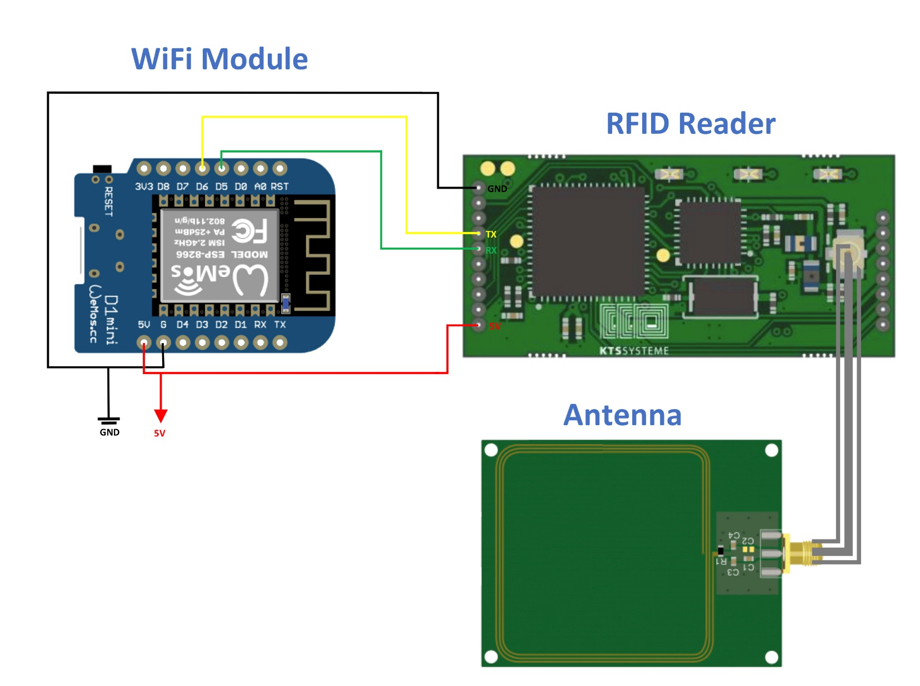
Planned Setup 1
Controller
WiFi module
Robot
Notes:
Plan: To connect the RFID with the robot built in microcontroller and then the robot will send the data through the network using its own Wifi module, but found out that all the serial communication ports on the controller are busy

Slide 21
Planned Setup 2
New
Controller
New WiFi module
New Setup
Notes:
Plan: To connect the RFID with a new microcontroller and new WiFi Module and then will send the data through the network, but this will be within an extra cost. New plan is to develop a wifi module to receive the data directly from RFID and send it through the network

Slide 22
Developed Setup
Notes:
(RX,TX) is the process of sending and propagating an analogue or digital information signal over a physical point-to-point (wired)

Slide 23
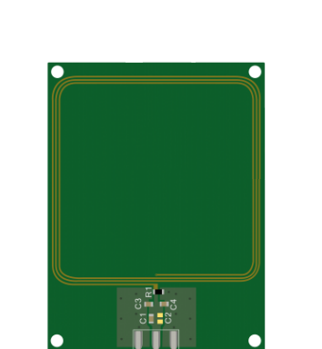
Hardware Setup

Slide 24
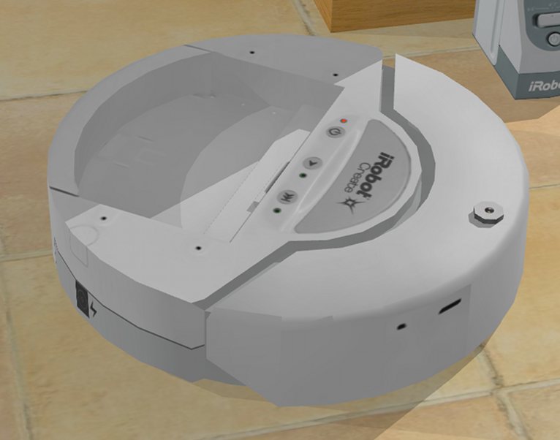
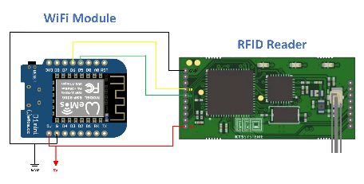
Hardware Setup

Slide 25
Simulation + Emulator
Emulator to create artificial RFID reader data
Answer design questions in validation (model based)
Parameter:
Size plant [1x1m]
Robot position + properties
Reading ranges [0-10cm]
Distance between the tags [10cm]
Number of measurements for each 360°turn (Init Proc)
Output: (txt file)
Measurement direction of robot
Detected unique identification (UIDs)
Related received signal strength indicator (RSSI) [0...7]

Slide 26
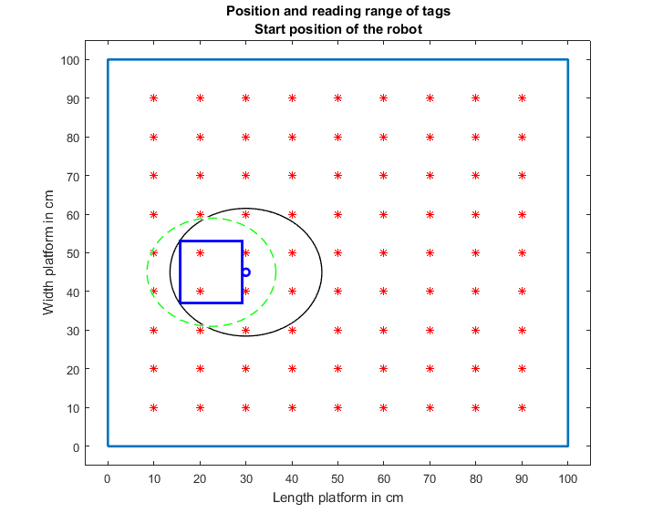
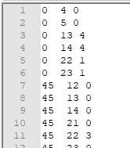
Emulator
Direction [˚]
UID
RSSI
Robot center o , dimension o
Position of the antenna ,Tags *
Max reading range of the antenna --

Slide 27
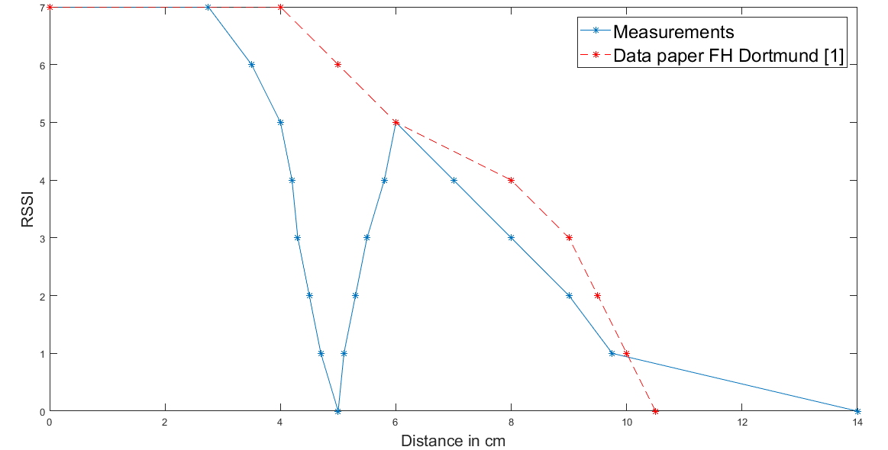
Simulation update
Measurements: inconsistency in RSSI and distance between tag and reader
[1] RFID-Based Localization of Mobile Robots, Christof Röhrig, Daniel Heß and Frank Künemund, FH Dortmund
Notes:
Order. circle

Slide 28
Possible reasons blind spot
The field and the inductor of the tag are perpendicular
Antenna
1.5 cm
Tag

Slide 29
Simulation results with emulated data
Used the code to estimate the initial position and orientation with the emulated data
Without inconsistence (data from paper):
Error in X,Y-Position: 2 mm
Error in orientation: < 1°
After the update (with blind spot):
Error in X, Y-Position: 10 mm
Error in orientation: 20°

Slide 30



Software Implementation
Reader
WiFi-Module
Receiving()
RX
TX
TX
RX
C#
Initialization()
C#
MPC()
Position()
Orientation()
C#

Slide 31
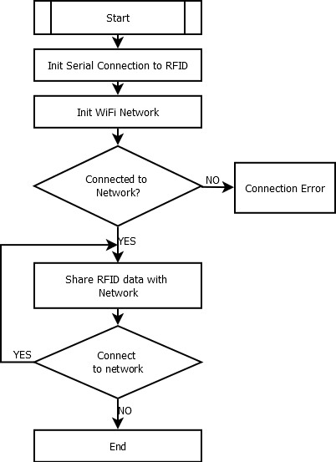
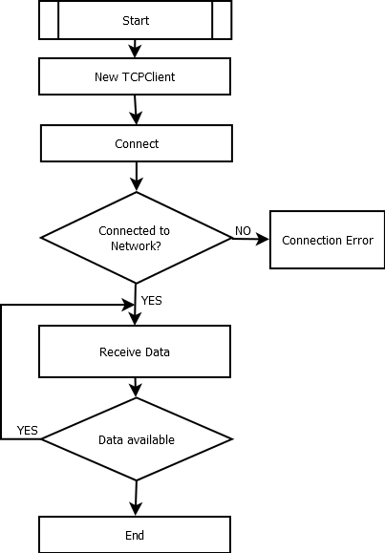
Transmitting Receiving

Slide 32
Software Implementation
SCAN:+UID=xxxxxxxxxxxxxxxx,+RSSI=x/x
Reader
WiFi-Module
Receiving()
RX
TX
TX
RX
C#
Initialization()
C#
MPC()
Position()
Orientation()
C#

Slide 33
Data Processing
Received Data via. WiFi
Filter bad readings by “-”
Split string at “OK”, ”\r”, “\n”, “SCAN+UID=“, “RSSI=“
Convert UID from hex to dec and separate from RSSI
SCAN:+UID=E00401503A5BD691,+RSSI=0/0
SCAN:-UID=E00401503A5BDAE4
SCAN:+UID=E00401503A5BD691,+RSSI=0/0
E00401503A5BD691 0/0
1681 0/0

Slide 34
Software Implementation
SCAN:+UID=E00401503A5BD691,+RSSI=0/0
Reader
WiFi-Module
Receiving()
RX
TX
TX
RX
C#
1681 0/0
Initialization()
C#
MPC()
Position()
Orientation()
C#

Slide 35
Initialization()
Why is a Initialization necessary?
Initialization procedure

Slide 36

Why is an Initialization necessary?

Slide 37
Why a 360°turn?

Slide 38
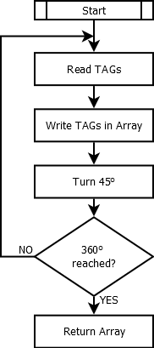
Initialization Procedure
 | ID1 | ID2 | ID3 | ID4 | ID5 | ID6 | ID7 | ST1 | ST2 | ST3 | ST4 | ST5 | ST6 | ST7
0° | 4 | 1 | 5 | 2 | 3 |  |  | 0 | 0 | 1 | 7 | 0
45° | 5 | 3 |  |  |  |  |  | 2 | 3
90° | 3 | 5 |  |  |  |  |  | 2 | 2
135° | 9 | 8 | 6 | 5 |  |  |  | 1 | 1 | 1 | 2
180° | 9 | 7 | 8 | 6 | 4 | 5 |  | 2 | 0 | 6 | 0 | 0 | 2
225° | 4 | 7 | 5 | 8 |  |  |  | 0 | 2 | 3 | 3
270° | 5 | 4 | 7 | 8 | 1 |  |  | 2 | 5 | 0 | 0 | 0
315° | 2 | 4 | 1 | 5 |  |  |  | 0 | 2 | 2 | 0

Slide 39
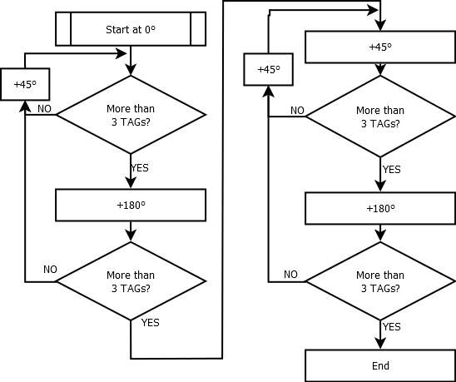
Analyzing Initialization Array[8,14]
ID1 | ID2 | ID3 | ID4 | ID5 | ID6 | ID7 | ST1 | ST2 | ST3 | ST4 | ST5 | ST6 | ST7
4 | 1 | 5 | 2 | 3 |  |  | 0 | 0 | 1 | 7 | 0
5 | 3 |  |  |  |  |  | 2 | 3
3 | 5 |  |  |  |  |  | 2 | 2
9 | 8 | 6 | 5 |  |  |  | 1 | 1 | 1 | 2
9 | 7 | 8 | 6 | 4 | 5 |  | 2 | 0 | 6 | 0 | 0 | 2
4 | 7 | 5 | 8 |  |  |  | 0 | 2 | 3 | 3
5 | 4 | 7 | 8 | 1 |  |  | 2 | 5 | 0 | 0 | 0
2 | 4 | 1 | 5 |  |  |  | 0 | 2 | 2 | 0

Slide 40
Software Implementation
SCAN:+UID=E00401503A5BD691,+RSSI=0/0
Reader
WiFi-Module
Receiving()
RX
TX
TX
RX
C#
1681 0/0
Initialization()
C#
Array[8,14]
MPC()
Position()
Orientation()
C#

Slide 41
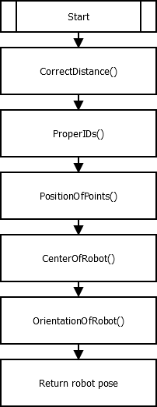
Initial position & orientation
Based on the recorded array
ID1 | ID2 | ID3 | ID4 | ID5 | ID6 | ID7 | ST1 | ST2 | ST3 | ST4 | ST5 | ST6 | ST7
4 | 1 | 5 | 2 | 3 |  |  | 0 | 0 | 1 | 7 | 0
5 | 3 |  |  |  |  |  | 2 | 3
3 | 5 |  |  |  |  |  | 2 | 2
9 | 8 | 6 | 5 |  |  |  | 1 | 1 | 1 | 2
9 | 7 | 8 | 6 | 4 | 5 |  | 2 | 0 | 6 | 0 | 0 | 2
4 | 7 | 5 | 8 |  |  |  | 0 | 2 | 3 | 3
5 | 4 | 7 | 8 | 1 |  |  | 2 | 5 | 0 | 0 | 0
2 | 4 | 1 | 5 |  |  |  | 0 | 2 | 2 | 0

Slide 42
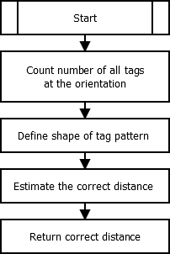
CorrectDistance()
Max
Min
RSSI | 0 | 1 | 2 | 3 | 4 | 5 | 6 | 7
Distance in [cm] | 14 | 9.75 | 9 | 8 | 7 | 6 | 3.5 | 2.75 | Max
Distance in [cm] | 5 | 5.1 | 5.3 | 5.5 | 5.8 | 4 | - | - | Middle
Distance in [cm] | - | 4.7 | 4.5 | 4.3 | 4.2 | - | - | - | Min

Slide 43
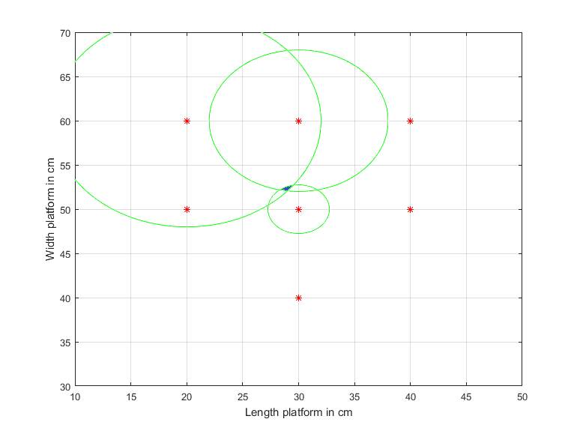
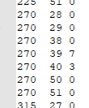
Trilateration
Using 3 defined positions + 3 radii to estimate the intersection point
Example
7 tags found
r₂
r₃
r₁

Slide 44
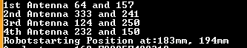
CenterOfRobot()
The intersection can easily be computed with the help of the four coordinates
Output of the console:
1st Antenna
4th Antenna
x₁,y₁
x₈,y₈
x, y
3rd Antenna
x₄,y₄
x₅,y₅
2nd Antenna

Slide 45
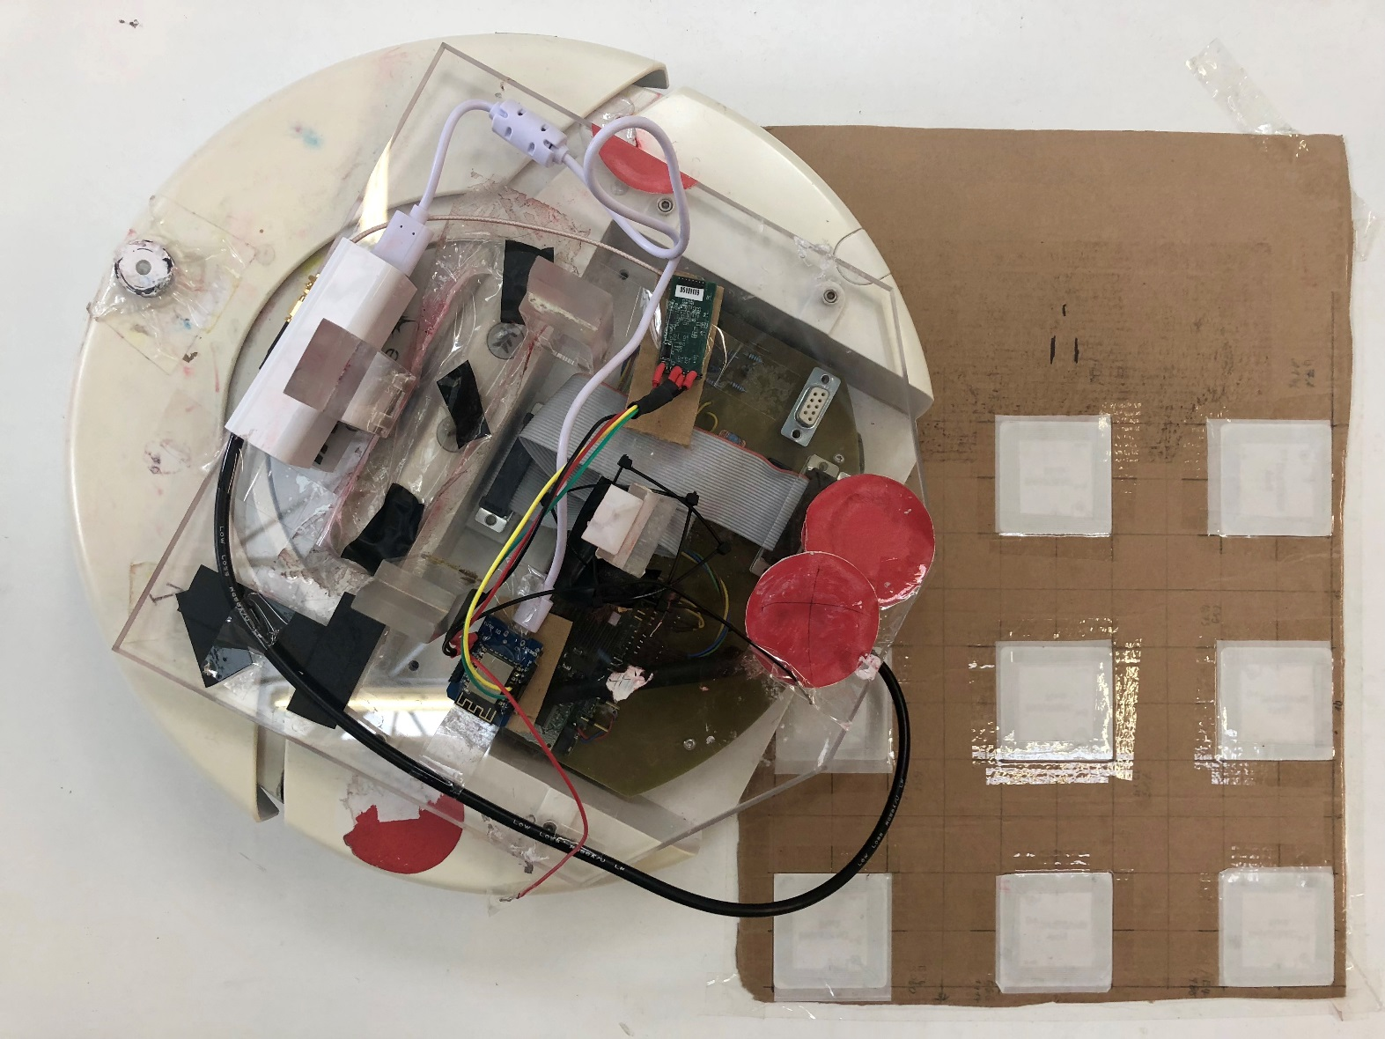
Initialization Procedure

Slide 46


Conclusion
An alternative positioning system was picked
Proof of concept was evaluated
Ultimate goal: Improve positioning precision
Light independent system was created
Highly scalable solution was found
Accuracy under perfect light condition was improved
Old Error: 50mm/3° New Error: 25mm/25°
Accuracy under bad light condition was improved
Old Error: 200mm/8°New Error: 25mm/25°
Processing time was improved
Old time: 100-400ms New Time: min 90ms
Notes:
Include data abt the accuracy !!

Slide 47
Future Work
Hardware
Use local power supply of the robot
Include 15V to 5V converter
Add more the TAGs on an extended plant model
Add RFID modules to all robots
Software
Initialization turn based on more accurate parameter than time.
Encoders of the robot
Delete unused camera modules in the code
Optimize the localization algorithm

Slide 48
Thank you for your attention!

